Slide 1
Ai2c technician cohort 7 lesson 1: intro to python

Slide 2
Setup

Slide 3
AI2C Technician Cohort 7
Lesson 1 – Intro to Python

Slide 4
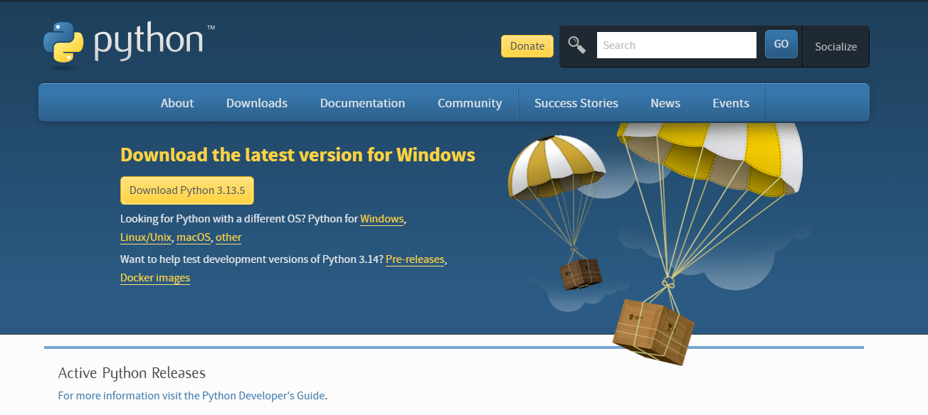
Let’s download Python
If you haven’t already… go to python.org and download the latest release of Python
Notes:
Take 3-5 minutes to let people download Python

Slide 5
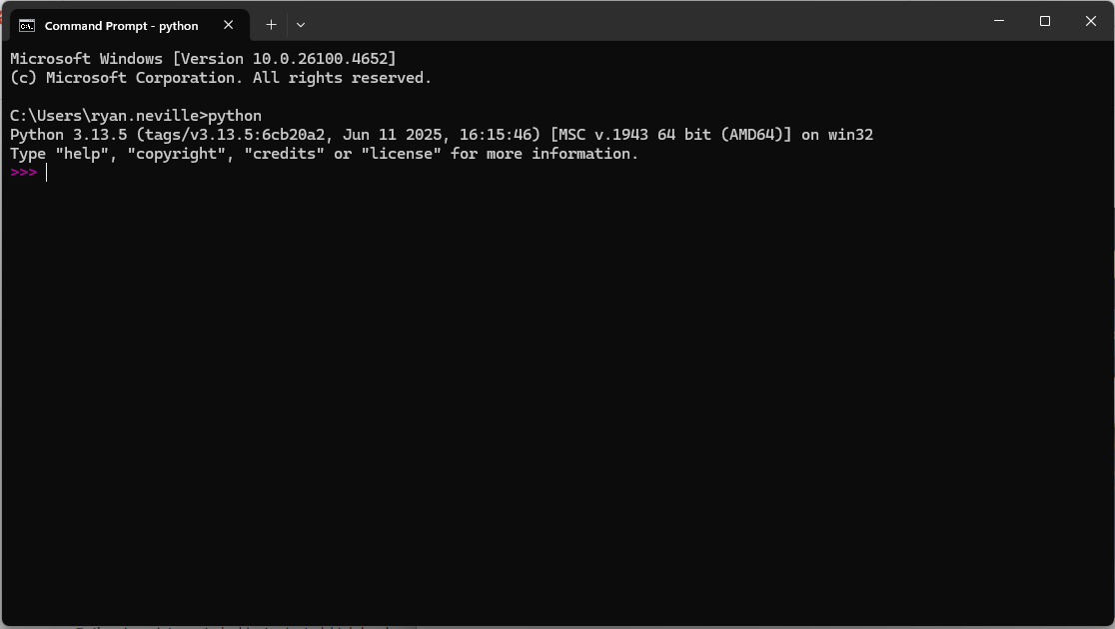
Verify the download
Open a command prompt and type in “python”. Your terminal should indicate it is running Python with the “>>>”
Run a few basic commands.
x = 5
x+2

Slide 6
Interactive Python
Running Python in the terminal like this is great way to interactively see what individual lines of code do but…
Oftentimes we want to run dozens (or hundreds) of lines of code at a time. For this, we want to write python scripts.
It would also be nice if there was software that would help us write and manage code, have useful plugins, be integrated with AI, etc…
We need an Integrated Development Environment (IDE)
Notes:
Give 3-5 minutes for download

Slide 7



Integrated Development Environments (IDE)
There are many IDEs that can help you write and manage code.
Visual Studio Code
PyCharm
Notepad++

Slide 8
Visual Studio Code
We use VS Code in AI2C, and you will use it for classes at CMU.
VS Code has great version control management built in and many great plug-ins
Take a few minutes to download VS Code

Slide 9
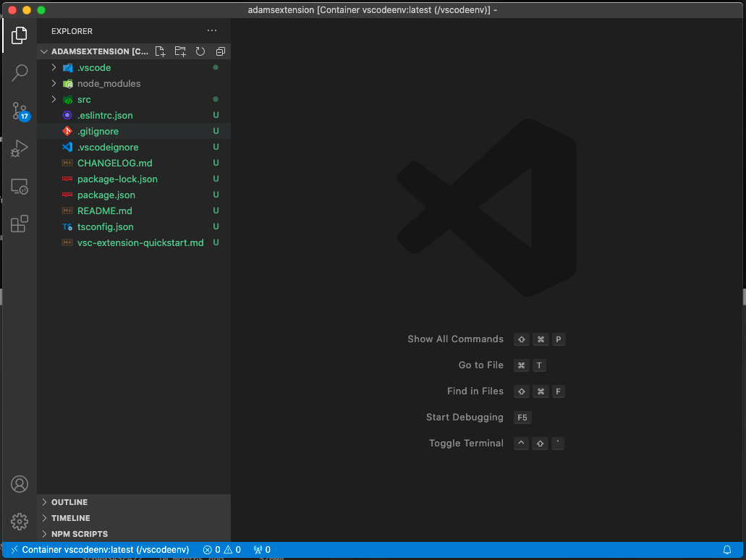
Running code in VS Code
Give a quick tutorial on using the terminal in VS Code

Slide 10

Saving Code on the Internet and version control?
Go to https://github.com and setup a github account.
Also download git at https://git-scm.com.

Slide 11
Programming

Slide 12
What is a Program?
A series of instructions
Executed in order
On a computer
Requires
Computation
Memory / storage
Generally, data is the most important thing
Process
Manipulate
Transform

Slide 13
So what is Python?
High-level, interpreted programming language
simplicity
readability
versatility
Widely used
Professionals, amateurs
Web dev, data science, automation, AI

Slide 14
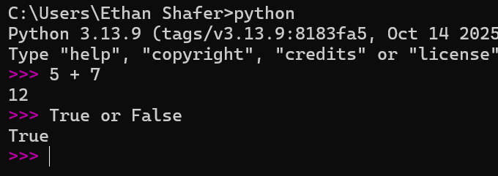
The Interpreter
Go to your terminal and start the python executable
The interpreter runs python code
Lines preceded by ‘>>>’ are instructions
Other lines are results
Expressions evaluate to a specific value
5 + 7 → 12
True or False → False
Statements do not evaluate to a specific value but may have other side effects (more on this later)

Slide 15
Data and datatypes
This is important.
Computers classify data into different datatypes. For instance:
6 is an integer
25.5 is a floating point number (float)
“Hello” is a string
True is a boolean
Python will interact with different datatypes differently.
Give examples of the following primitive datatypes:
Integers
Floats
Strings
Boolean

Slide 16
Spot the Difference
01100011011011110110111101101100
01100011011011110110111101101100
01100011011011110110111101101100
1,668,247,404 (int)
4.4168006258522776e+21 (float)
"cool" (string)
Notes:
binary_demo.py

Slide 17
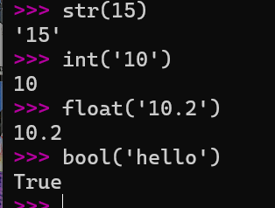
Data Type Conversion (Casting)
There are predefined functions we can use to explicitly convert data from one type to another:
int()
float()
str()
bool()
Notes:
Age1 = “18”
Age2 = “19”
Sum_of_ages = age1 + age2
Print(sum_of_ages) --🡪 1819
Let’s say I want to use how old you will be in 4 years.
Num = int(age1) + int(age2)
Print(num) --🡪 37
Print(type(num1))
Age1 = int(age1) <<< now age1 is an integer because we overwrote it.

Slide 18
Operators
Assignment
Comparison
Code | Meaning
x = 3 | Assignment
x += 3 | Add and assign
x -= 4 | Subtract and assign
x *= 5 | Multiply and assign
x /= 3 | Divide and assign
x //= 3 | Floor divide and assign
x %= 7 | Modulo and assign
Code | Meaning
x < y | Less than
x > y | Greater than
x == y | Equal to
x <= y | Less than or equal to
x >= y | Greater than or equal to
x != y | Not equal to
Arithmetic
Code | Meaning
x + y | Addition
x + y | Concatenation
x - y | Subtraction
x * y | Multiplication
x / y | Division
x // y | Integer/floor division
x % y | Modulo (remainder)
-x | Negation
x ** y | Exponentiation
Logical
x += 1
is equivalent to
x = x + 1
and other assignment operators are similar.
Code | Meaning
x or y | True if either is true
x and y | True only if both are true
not x | True if x is false
Reference: https://docs.python.org/3/library/stdtypes.html

Slide 19
Order of Operations
The order of operations in Python is essentially the same as in math you are already familiar with:
Expressions in parentheses
Exponentiation
Multiplication, division, integer division, and modulo (remainder)
Addition and subtraction
Operators with the same precedence (except for **) are evaluated from left-to-right. (In algebra we say they are left-associative.)
Notes:
PEMDAS
Please Excuse My Dear Aunt Sally
Parentheses, Exponent, Multiply/Divide, Add/Subtract

Slide 20
In Class Exercise 1
Run the following code snippets in the interpreter. What do they do?
How do we fix the last one?
10 + 15
"10" + "15"
10 + "15"

Slide 21
Variables

Slide 22
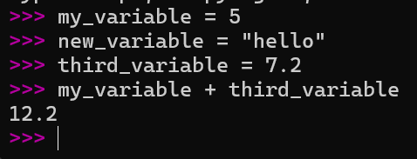
Variables
Variables are stored in memory
Can be read
Can be written
Can be deleted
Used for short-term storage
Let’s fill in the table on the right…
Name | Memory Addr | Type | Value
my_variable | 0x00000000 | int | 5
new_variable | 0x00000001 | str | "hello"
third_variable | 0x00000006 | float | 7.2
How does the computer calculate the value for the last line?

Slide 23
Wait a minute…
What was the result of the first line?
Is that a statement or an expression?
Important! Statements do not give a value back.
Expressions do evaluate to a value.
Statements can contain expressions

Slide 24
Variable Naming Rules and Conventions
You can name a variable anything but…
cannot start with a number.
cannot include special characters (&*^%!)
cannot have any spaces
cannot be a python keyword (for, if, else…) (You’ll learn more keywords as you learn the language)
Your variable name should…
describe something about the data
use_snake_case_for_variables
UseCapWordsForClassNames
Use ALLCAPs for constants

Slide 25
In Class Exercise 2
A Pittsburgh pizza shop is having a two-for-one deal. You can get two small (12”) pizzas for $9.99. In contrast, a large pizza (16”) costs $9.99. Which one is the better deal (yields more area)?
What is your first intuition?
With a partner, write a plan on how to solve the problem
Then write Python code in the interpreter to answer this question.
Use variables to store data for later
Use 3.14 for pi
area = pi * radius ** 2

Slide 26
Take a Break

Slide 27
Scripts

Slide 28
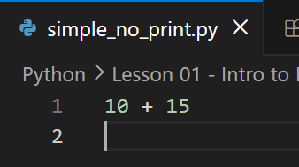
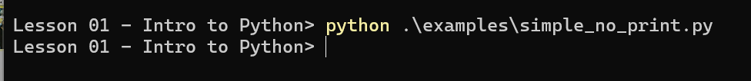
Scripting
A python script is a text file
By convention, filename ends with .py
Contains a series of python statements
When executed, runs all statements, in-order
Statements are not shown like the interpreter
Expressions are not shown like the interpreter
Use print() function to display values to the terminal
Run with `python <path_to_script>`

Slide 29
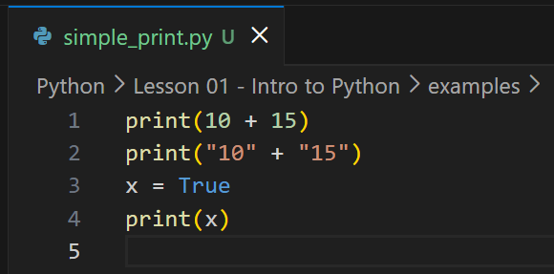
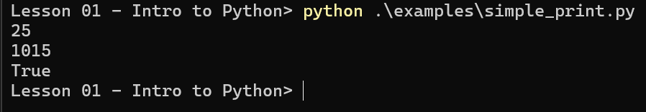
Another Example

Slide 30
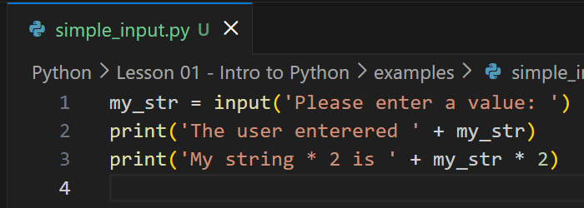
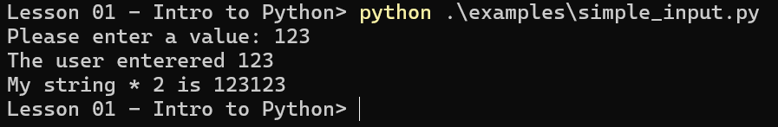
Interacting With Scripts
Right now, we can only enter text to interact with our scripts
The input() function waits for the user to type something and hit enter
Always gives you a string back

Slide 31
In Class Exercise 3
Write a script that prompts the user for a diameter and outputs the area
Remember to convert from string to another datatype
Stretch goal #1: write a script that calculates the price per area. The user should input the diameter and the cost.
Stretch goal #2: write a script that calculates the best deal. The user should input three diameters (two for the first deal, one for the second deal), and the two costs.
Solutions available in the lesson folder

Slide 32
Questions

Slide 33
Final Exercise
Copy the lyrics of your favorite song into a string variable.
Determine all the unique words in the song and the number of times they occur.
*DISCLAIMER* You will not be able to do this with only what you have been taught so far. The intent is that you try to think through this for a little bit and inevitably look up a solution. This exposes you to some of the things we are going to learn later on.
5 different solutions for this are given in Lesson01FinalProblemSolution.py

